Slide 1
Work Life Webinar
Week two: who has time?

Slide 2
Notes:
Do not modify the notes in this section to avoid tampering with the Poll Everywhere activity. More info at polleverywhere.com/support Have you ever answered the question "how have you been?" with "busy"?
https://www.polleverywhere.com/multiple_choice_polls/DMRVDfZj0Oujdw1xQRtwg?display_state=instructions&activity_state=opened&state=opened&flow=Engagement&onscreen=persist

Slide 3
Notes:
Do not modify the notes in this section to avoid tampering with the Poll Everywhere activity. More info at polleverywhere.com/support Have you ever answered the question "how have you been?" with "busy"?
https://www.polleverywhere.com/multiple_choice_polls/DMRVDfZj0Oujdw1xQRtwg?display_state=chart&activity_state=opened&state=opened&flow=Engagement&onscreen=persist

Slide 4
Notes:
Do not modify the notes in this section to avoid tampering with the Poll Everywhere activity. More info at polleverywhere.com/support Have you ever answered the question "how have you been?" with "busy"?
https://www.polleverywhere.com/multiple_choice_polls/DMRVDfZj0Oujdw1xQRtwg?display_state=chart&activity_state=closed&state=closed&flow=Engagement&onscreen=persist

Slide 5
we are obsessed with being “busy”
“Being busy makes them feel productive and important, they say. Admitting you take time for yourself is tantamount to a show of weakness. The thought of leisure time makes them feel … guilty.”
“Busyness is now the social norm that people feel they must conform to, […] or risk being outcasts.”
From Overwhelmed: Work, Love, and Play When No One Has the Time

Slide 6
what is your ideal schedule?
Activity:
In your journal, take some time to sketch out what your ideal day would look like
Things to consider:
When do you work best?
What are things you need to do every day for your health and happiness?
What are things that you need to do every day for your work?
How would an ideal weekday differ from an ideal weekend?
You can elaborate as much as you want on this, but start with a rough sketch.

Slide 7
what is your ideal schedule?
Breakout rooms
How does the schedule you just mapped out differ from how you usually spend your days?
What might be stopping you from following your ideal schedule?
Is there any way you can minimize those differences and shift your schedule to be just a little closer to your ideal?

Slide 8
time affluence
Podcast: The Happiness Lab – For Whom the Alarm Clock Tolls

Slide 9
time affluence
Podcast: The Happiness Lab – For Whom the Alarm Clock Tolls
Time fragmentation – “time confetti” contributes a lot to this sense of time famine.

Slide 10
where does the time go?
Remember from last time: the average “knowledge worker” spends more than 60% of the work week on electronic communication and internet search (from a McKinsey study done in 2012)
How does switching between tasks affect our productivity?
Attention residue: the idea that some of our attention remains stuck with our previous activity when we start a new one (Leroy, “Why is it so hard to do my work?”)
Switching costs: constant leaping from task to task prevents us from completing any task to our best ability, leading to mistakes and wasted time (APA, Multitasking: Switching costs)

Slide 11
where is your time going?
When you did your assignment for this week, where did you estimate most of your time was going?
How accurate do you think your estimate is?

Slide 12
where is your time going?
It can be really hard to manage time when we don’t know how we’re spending that time
Time tracking can help you answer these questions:
Where is my time going?
How fragmented is my time?
Am I spending more time on nonessential work tasks?
Do I actually get enough time to recharge?

Slide 13
time tracking
This is common practice for lawyers and consultants, whose work is billed to different projects
It can be useful for all kinds of work, though
The basic concept: divide your day into 15 minute chunks, and note what you are doing during each of those increments

Slide 14
how to track your time
Apps
Toggl: https://toggl.com (free)
ATracker: https://atracker.pro/home.html (free)
Clockify: https://clockify.me/ (free)
Harvest: www.getharvest.com (not free)
Timely https://memory.ai/timely (not free)
HourStack https://hourstack.com/ (not free)
Pros to the app strategy: quick, easy, convenient
Cons to the app strategy: more screen time, higher likelihood of getting distracted by your phone, not super flexible categorization of the time

Slide 15
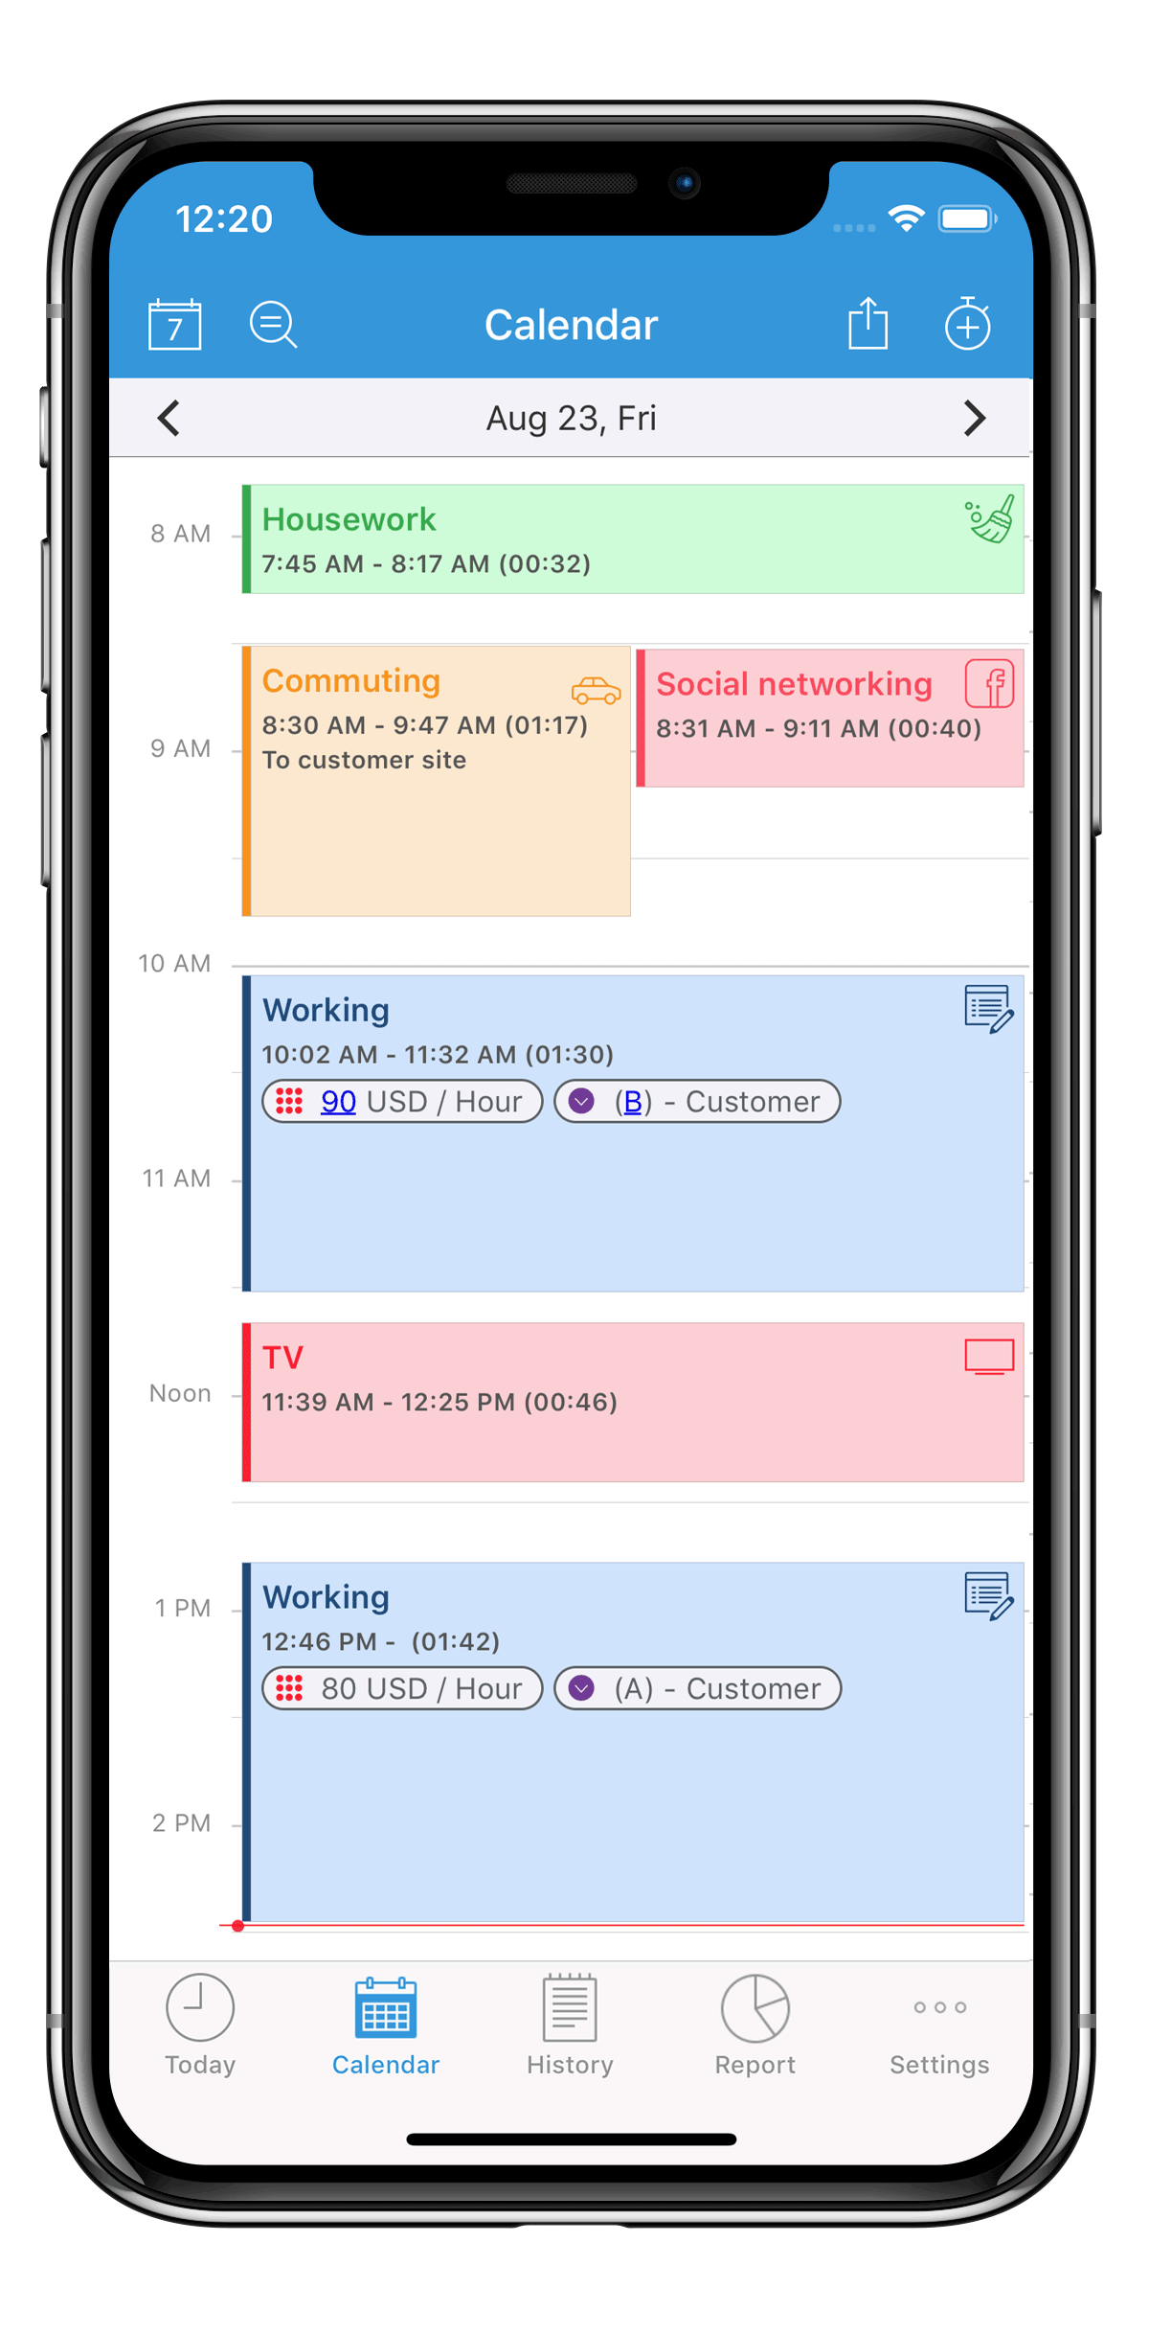
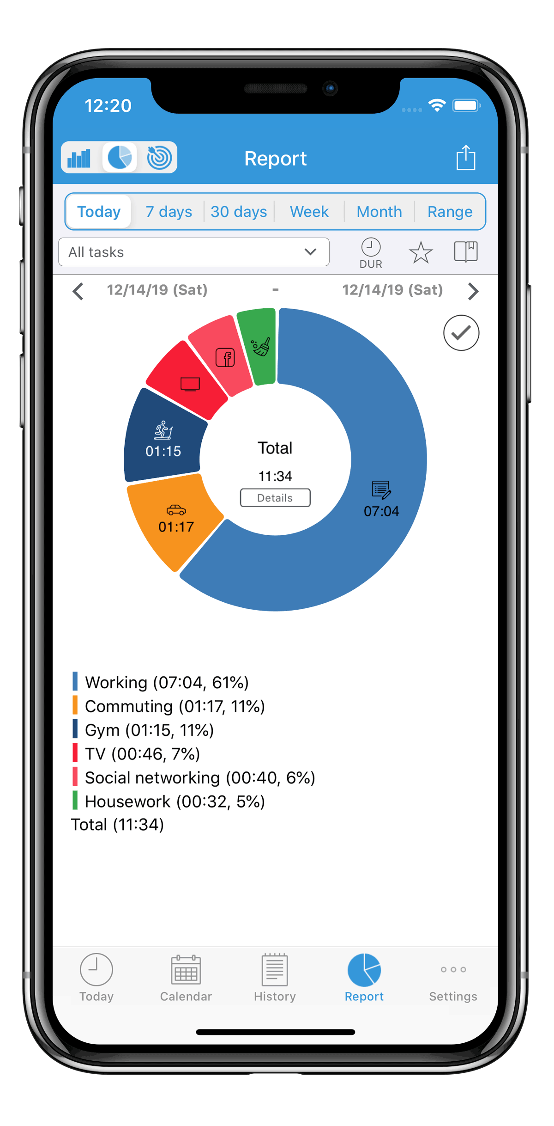
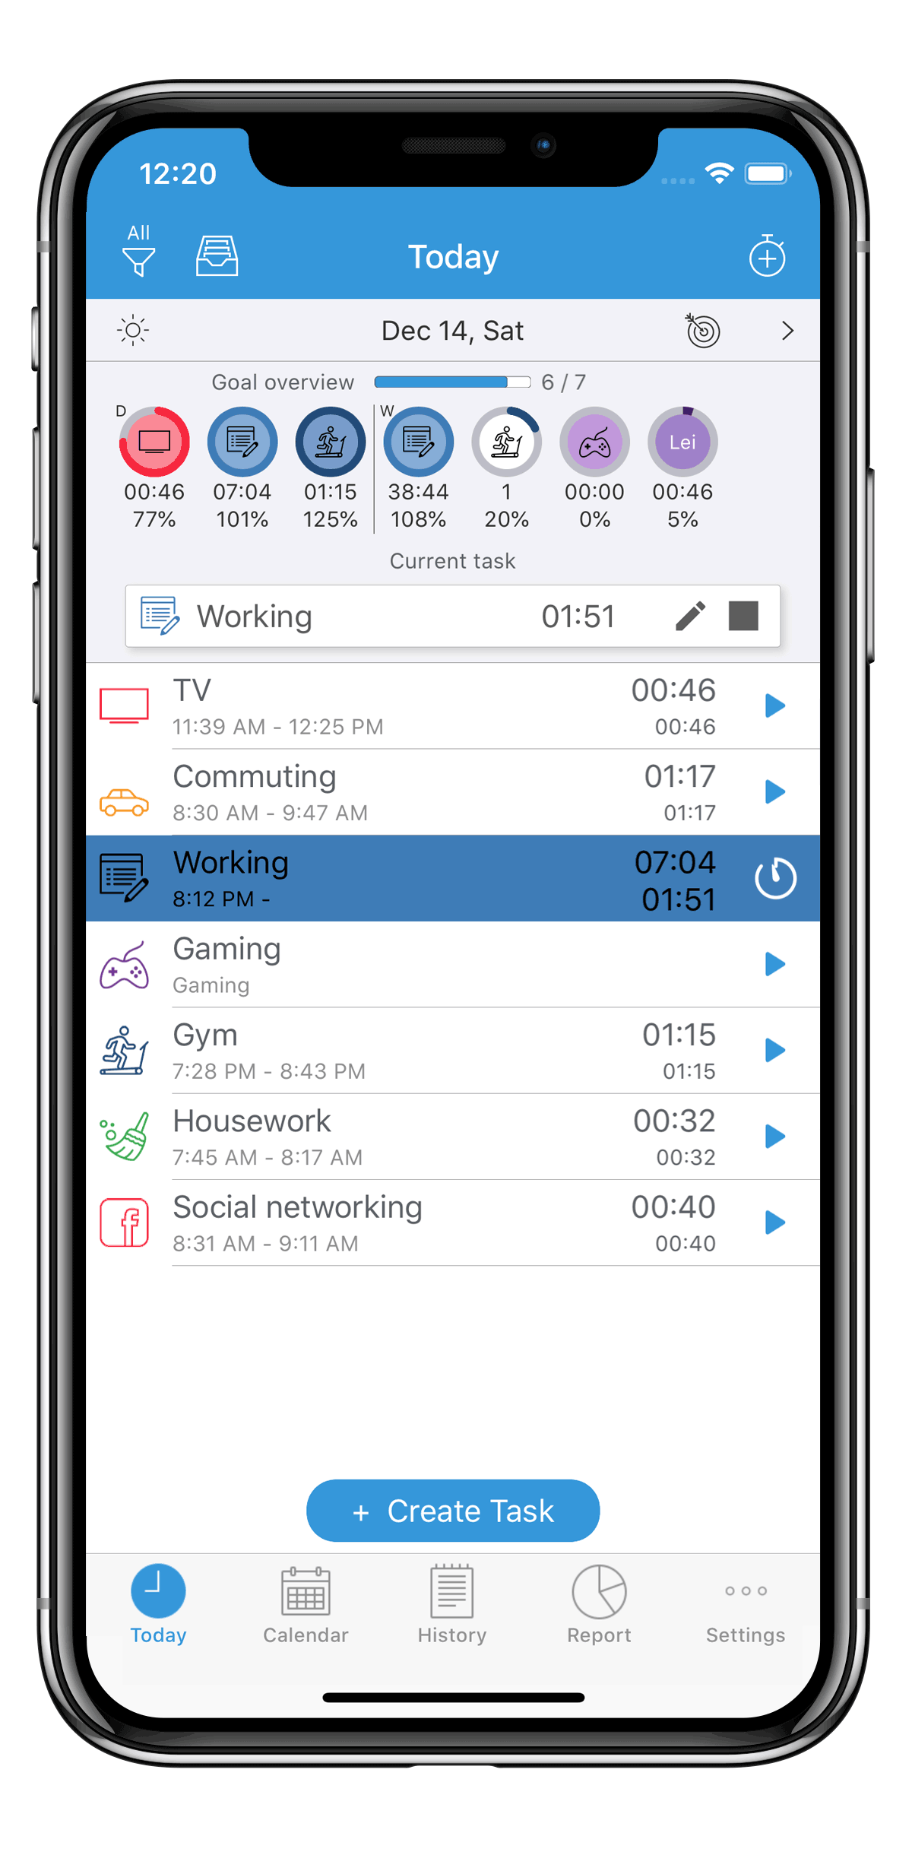
ATracker

Slide 16
how to track your time
Digital, self-structured
Spreadsheets (excel, google sheets, numbers)
Word processing software (word, pages, google docs, evernote, notion, notability)
Calendar software (apple, google, outlook, etc)
Pros to the digital self-structured strategy: more flexibility, use something you already own
Cons to the digital self-structured strategy: takes more work, requires being near your computer

Slide 17
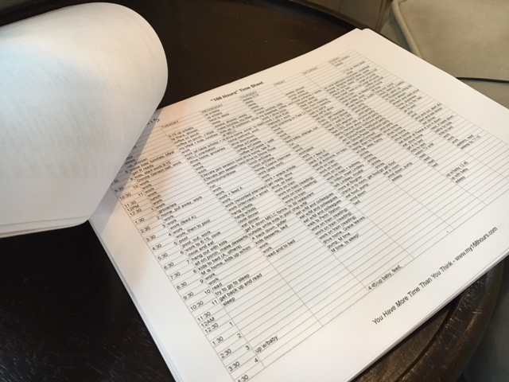
Excel

Slide 18
how to track your time
Analog, self-structured
Dot journal
Time-tracking notebook
Pros to the analog self-structured strategy: no possibility of technological distraction, designated location for time tracking, can customize notes, etc.
Cons to the analog self-structured strategy: no way to aggregate data, more effort needed

Slide 19
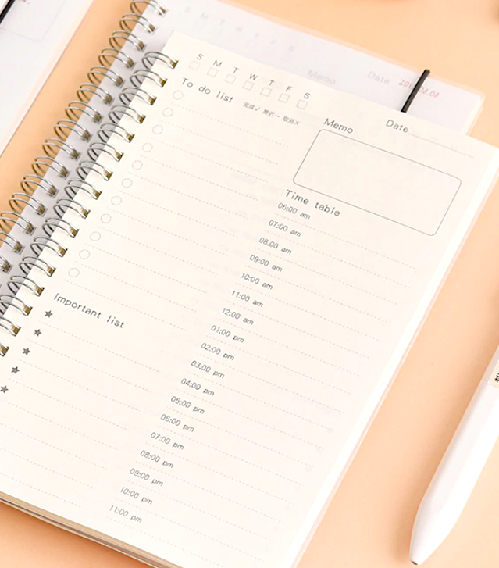
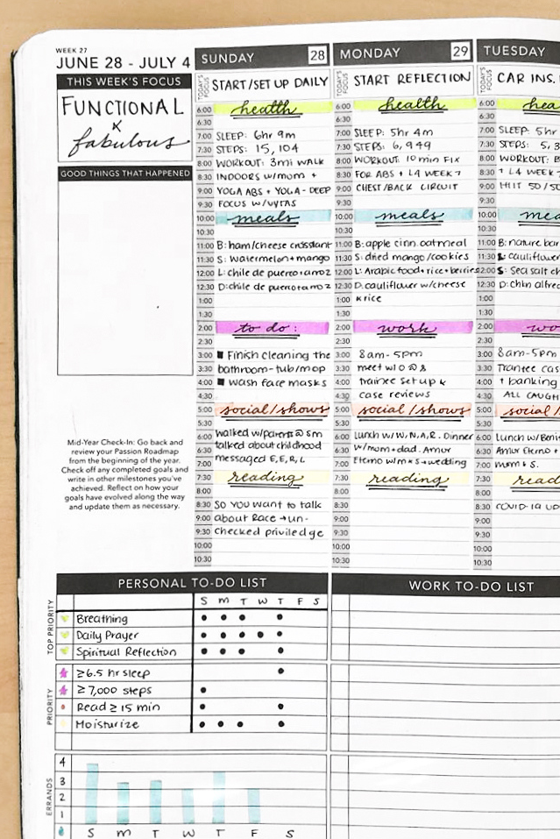
dot journal or notebook

Slide 20
benefits of time tracking
Learn what you are actually prioritizing with your time
Recognize signs of overwork
Discover time-wasters (and get rid of them!)
End result: more strategic use of your time can help you be more efficient, and therefore more productive
“Happy ideas come unexpectedly without effort like an inspiration, as far as I am concerned. They have never come to me when my mind was fatigued or when I was at my working table.” – Hermann von Helmholtz

Slide 21
too much of a good thing?
Remember: if any of these skills or practices start being a burden and adding stress to your life, stop
How much time tracking is too much?
More is better to start, but back off when it becomes too much
Ultimately, it’s up to you
This tool is intended to alleviate stress, not add to it

Slide 22
my soapbox
I just touted the value of time tracking for increasing your productivity, but it can also help you take back your time for yourself.
Your worth is not in how hard you work or how much you get done.

Slide 23
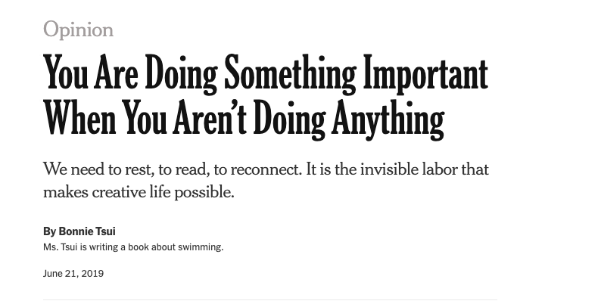

Slide 24
my soapbox
“I don’t mean for fallow time to be seen as just another life hack, the way that even meditation has been hijacked as something that will boost your productivity. The upside of this kind of downtime is more holistic than that — it’s working toward a larger ecology of workers who are recognized as human beings instead of automatons.”
From “You Are Doing Something Important When You Aren’t Doing Anything,” New York Times, 2019: https://www.nytimes.com/2019/06/21/opinion/summer-lying-fallow.html

Slide 25
how to be efficient with your time
Get distracted less!
Okay, but how?

Slide 26
how to be efficient with your time
Track your time – identify where it is going and how it’s divided up
Once you identify the time wasters in your schedule, how do you get rid of them?
Batch tasks that tend to fragment your focused working hours
Start saying no to things you don’ t have to do

Slide 27
how to be efficient with your time
Use a productivity method like Pomodoro/time sprinting
Set time intervals for tasks and focus on only that task until the timer goes off
Apps can help keep you on task:
Traditional: Focus Keeper, Pomodor, Toggl, Be Focused
Gamification: Forest, Flora, Challenge Timer
Power hour – challenge yourself to get as many items checked off your list as you can in an hour (or 30 minutes… or 10 minutes…)

Slide 28
how to be efficient with your time
Reduce number of tasks you need to do
Eisenhower matrices

Slide 29
Eisenhower matrices

Slide 30
Eisenhower matrices
Activity:
Pick eight items that were on your to-do list this week
Or: think of eight tasks that are currently stressing you out
In your journal, draw up an Eisenhower matrix and assign each of those eight tasks to one of the boxes

Slide 31
takeaway messages…
Time fragmentation and attention residue can make an already busy day feel overwhelming
Being mindful of where your time is going takes some work, but can reduce stress in the long run
You are allowed to do nothing sometimes! It’s even good for you!
In a culture that values busy-ness, it can be hard to protect your leisure time.

Slide 32
in the next two weeks…
Assignment # 1: Pick your favorite time tracking method and do a detailed inventory of how you spend your time for one whole work week
At the end of the week, reflect on your journal on the time logs you kept. Did anything surprise you?
Assignment #2: In your journal, make a list of every “project” you are on
This doesn’t have to just include research and teaching – count any time commitment that regularly appears in your life

Slide 33
resources
I will add content for week two to the website which will contain:
A copy of the slides
Detailed description of the assignments
An updated list of tools and resources mentioned
Start being mindful of your time, and try to carve out some empty space in your schedule when you can!

Slide 34
thank you!
If you have any questions, feel free to contact me
✉️ cberger@smith.edu
🖥 www.caseyeberger.com

