Slide 1
Work-Life Webinar
Week 4: what about life?

Slide 2
deep versus shallow work
Deep work: “Professional activities performed in a state of distraction-free concentration that push your cognitive capabilities to their limit. These efforts create new value, improve your skill, and are hard to replicate.”
Shallow work: “Noncognitively demanding, logistical-style tasks, often performed while distracted. These efforts tend to not create much new value in the world and are easy to replicate.”
From “Deep Work” by Cal Newport

Slide 3
freeing and frustrating
So much of our time is spent on things that bring us neither joy nor success
How can we break this habit?

Slide 4
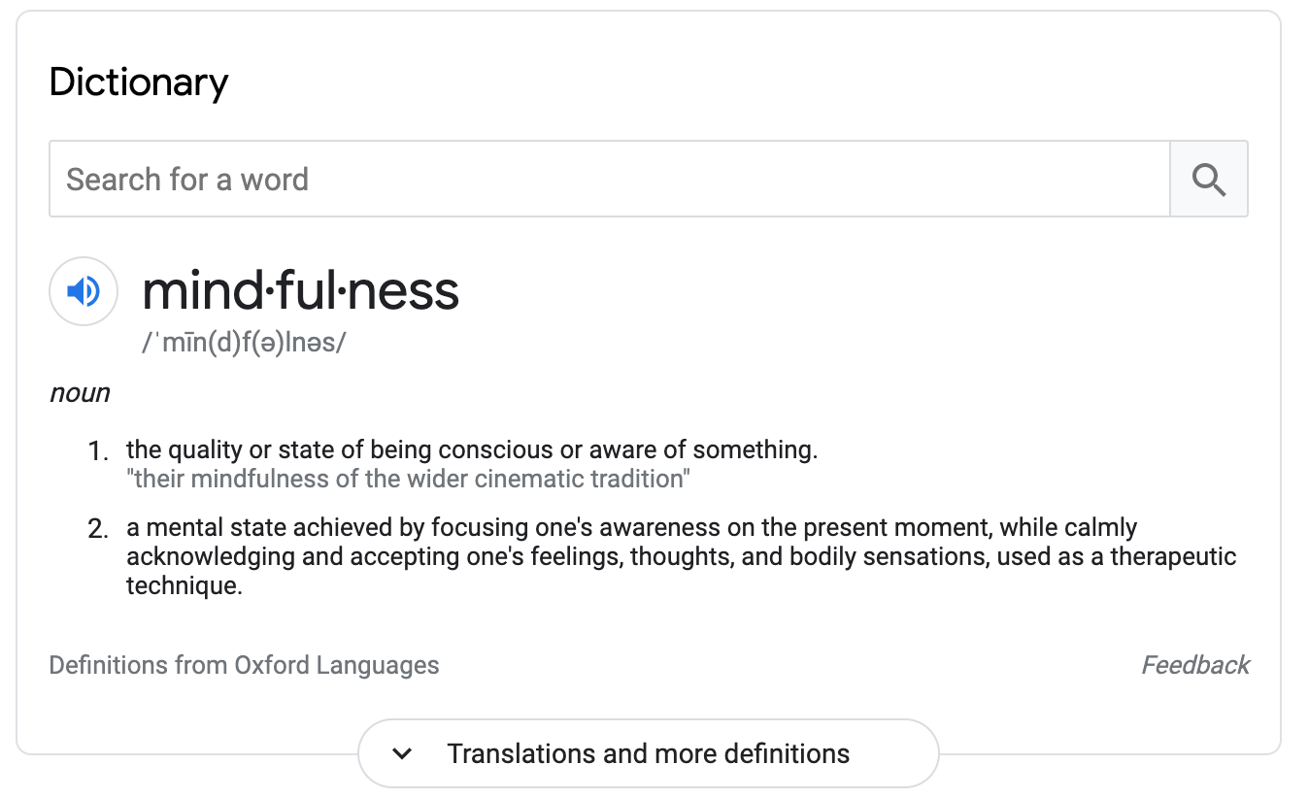
mindfulness
You don’t have to take up meditation or yoga
Just start to become aware of when distractions arise
Be deliberate (“intentional”) about your time
A little planning goes a long way

Slide 5
activity: WOOP
Remember WOOP?
Wish, Outcome, Obstacle, Plan

Slide 6
activity: WOOP
Wish: what is the wish or goal you would like to fulfill?
Outcome: what is the best result or feeling that will come from fulfilling that wish or goal?
Obstacle: what internal thing is holding you back from accomplishing your wish or goal?
Plan: If [obstacle], then I will [action]

Slide 7
activity: WOOP
Remember WOOP?
Wish, Outcome, Obstacle, Plan
Wish: to spend less time on the things that are neither helpful for your work nor your mental health
Now, you fill in the rest, and we’ll discuss in breakout rooms

Slide 8
what to do with this extra time
Don’t spend it all on work
“Why not? Won’t that make me super extra amazingly productive?”
Nope

Slide 9
limits on productivity
Studies suggest that even with years of practice and good habits, the human brain can’t maintain deep focus for more than about four hours in a day - from “Deep Work” by Cal Newport
Quality over quantity
Some shallow work is unavoidable, but the heart of what you do is deep work: don’t forget that

Slide 11
why waste time on rest and recovery?
Hint: it’s not wasted time at all
“Happy ideas come unexpectedly without effort like an inspiration, as far as I am concerned. They have never come to me when my mind was fatigued or when I was at my working table.” – Hermann von Helmholtz
Rest and recovery are essential to both your work success and your mental health

Slide 12
why waste time on rest and recovery?
“We live in an era when we’re urged to be passionate about our work. To regard the boundary between work and life as an obsolete relic of the industrial age. Mobile technologies keep us connected to the workplace day and night. At the same time, the boundaries between work and life are blurred, giving us more flexibility and choice about how to organize our time. Together, they create the illusion that we’ll find greatest fulfillment and be most effective if we’re always working. But that’s wrong. The positive effects of time off from work – of being able to completely leave the cares and pressures, and even the positives, of the workplace behind – are by now too well-documented to ignore, as are the negative effects of burnout.” - from “Rest” by Alex Soojung-Kim Pang

Slide 13
rest and recovery
Rest
“Vacations are like sleep – you need to take them regularly to benefit.” - from Rest, by Alex Soojung-Kim Pang
Work is just like everything else: choose quality over quantity
Recovery
A break from work doesn’t have to mean doing absolutely nothing
“Deep play” is renewing and energizing

Slide 14
deep play
Deep play has four characteristics:
It’s mentally absorbing
It provides a new context for the same skills used in work
It satisfies like work, but with “different, clearer rewards”
It evokes nostalgic and personal connections
“Creative people don’t engage in deep play despite their high levels of activity and productivity; they’re active and productive because of deep play.” - from “Rest” by Alex Soojung-Kim Pang

Slide 15
deep play
Deep play doesn’t have to look like a miniature version of your work
You can apply problem-solving skills to anything: hiking, painting, writing, video games, model building, sailing, running…

Slide 16
deep play
Examples of deep play:
Weightlifting:
Mental absorption: you have to focus on your body if you want to do it well
New context: strategic improvement on improving a skill, but physical not cognitive
Satisfaction: you feel good when you’re done, and you can watch your body grow stronger
Connection: reminds you of sports you used to play/of doing cartwheels in the backyard/of competing with friends to do pushups

Slide 17
deep play
Examples of deep play:
Reading a novel:
Mental absorption: you have to use your imagination to picture the scenes
New context: making connections between clues the writer has left (foreshadowing) instead of between data points
Satisfaction: you can finish a book faster than a project, and now you’ve explored an entire world!
Connection: reminds you of daydreaming as a child, the themes connect deeply for you, etc

Slide 18
deep play
Examples of deep play:
Baking:
Mental absorption: if you mix up the baking soda and powder, things will end badly
New context: producing a new whole by mixing together substances, only it’s safe to eat!
Satisfaction: in a few hours, you have a cake or cookies or something beautiful and tasty
Connection: reminds you of eating cookies and milk as a kid

Slide 19
deep play
Deep play doesn’t have to look like a miniature version of your work
You can apply problem-solving skills to anything: hiking, painting, writing, video games, model building, sailing, running…
Having an engaging and challenging hobby forces your brain to focus on something other than work

Slide 20
what do you enjoy?
Take a minute to answer these questions in your journal:
What skills or activities drew you to your work in the first place?
What deep play activities might allow you to practice some of those skills and activities in a different medium, pace, or scale?
We’ll talk about these in breakout rooms

Slide 21
how do I make time?
Schedule your deep play and your rest (and maybe your deep work, too)
Try to reduce time spent on shallow work using methods we’ve already discussed in previous weeks
Take vacation time, even if it’s just to stay home and read books
Strengthen those boundaries between work and life

Slide 22
takeaway messages…
You need regular rest and recovery to be productive and healthy and happy
Best practices mean protecting your rest and recovery time, and protecting your deep work time
There’s no “one weird trick” that will do this for you – you have to learn how to do this effectively through trial and error
Be mindful throughout this process – there is no one right way to approach it. Listen to yourself.

Slide 23
in the next two weeks…
We have no more webinars, but I encourage you to continue practicing setting boundaries, tracking your work time, cultivating rest and recovery time, and reflecting on your experiences through journaling

Slide 24
resources
I will add content for week four to the website which will contain:
A copy of the slides
An updated list of tools and resources mentioned
Find some time for deep play, and start cutting out the things that make you neither happy nor productive!

Slide 25
thank you!
If you have any questions, feel free to contact me
✉️ cberger@smith.edu
🖥 www.caseyeberger.com

