Slide 1
Communicating our science
What physicists can learn from Hollywood

Slide 2
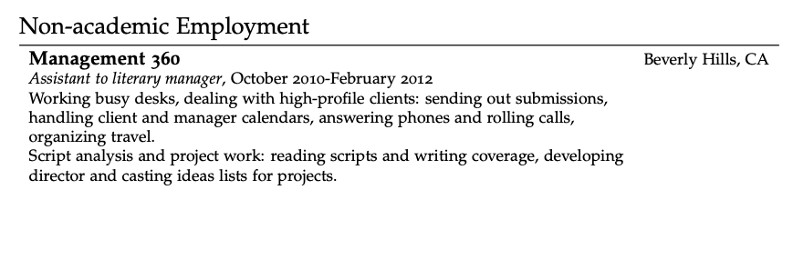
Before I was a physicist…

Slide 3
Activity: what makes you love a film/book?
What makes you start reading/watching?
What makes you keep reading/watching?
What makes you go back for more?

Slide 4
Hollywood is good at making a point fast
The elevator pitch – how to hook someone in 30 seconds
“Tell me your story in two sentences.”
The log line
Condenses the screenplay’s essence into just one to two sentences, 25-50 words long.
Not to be confused with the tag line (under 25 words) – usually used as a marketing tool on posters
Notes:
https://screencraft.org/blog/101-best-movie-loglines-screenwriters-can-learn-from/

Slide 5
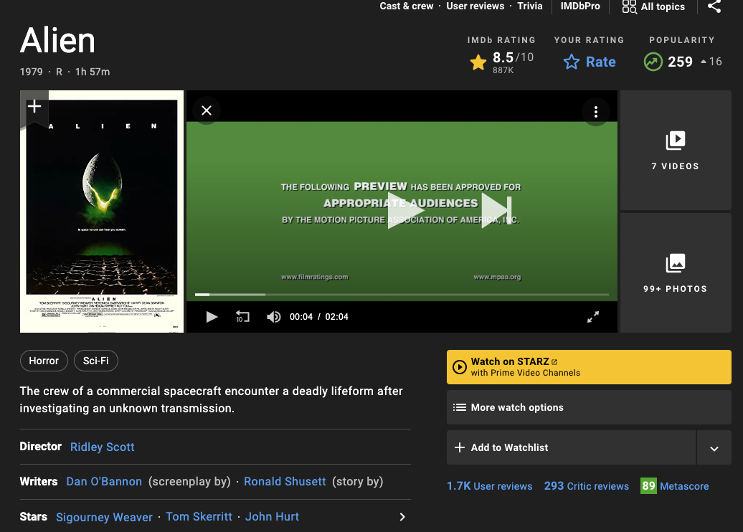

Slide 6
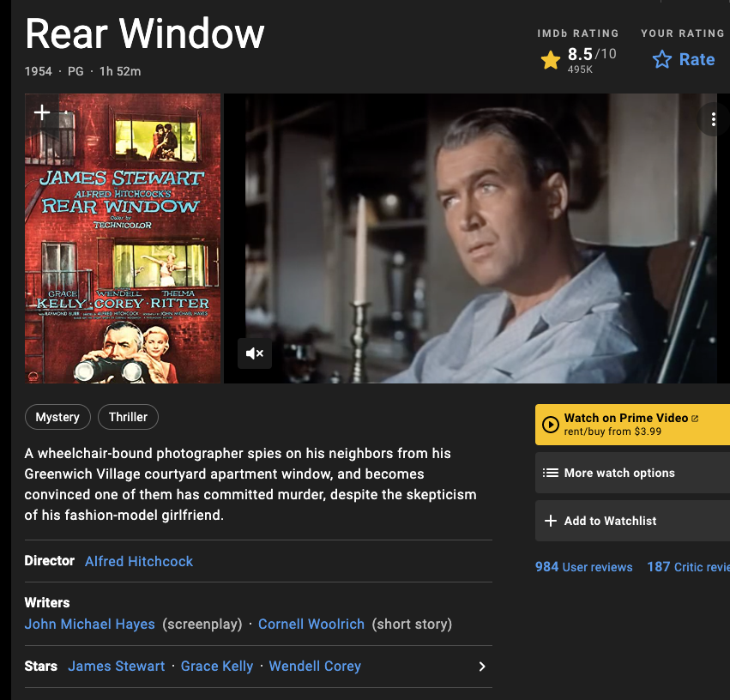
Activity: find the logline for your favorite film
Go on IMDB.com
Look for some of your favorite movies
Write down the logline

Slide 7
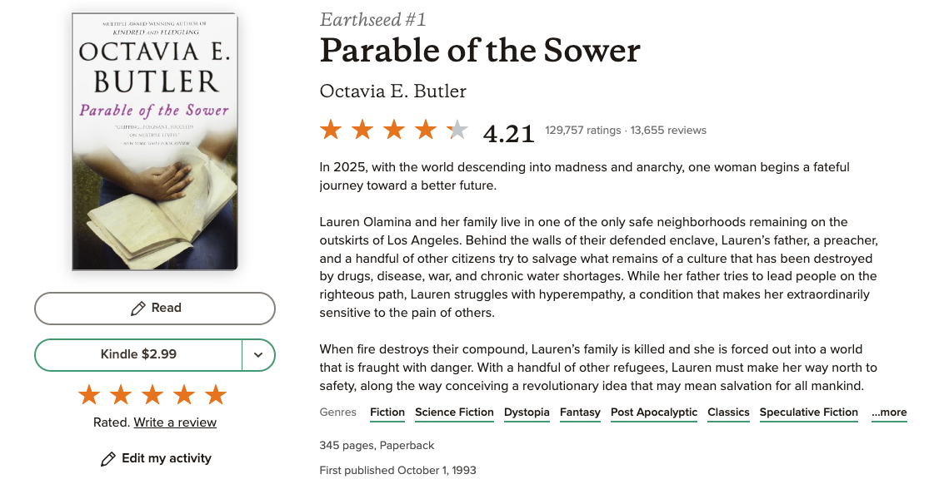
Back cover blurbs: literary log lines
Back cover blurbs do the same thing in more words
Go to goodreads or amazon and find your favorite book
Save the blurb

Slide 8
Activity: what do these have in common?
In small groups, talk about what you notice about your loglines and blurbs. What do they tell us? What stands out?
Crucial elements
Protagonist(s)
Goal
Stakes
Obstacles

Slide 9
What does this have to do with science?
Protagonist(s)
Goal
Stakes
Obstacles
You!
What is the question you’re trying to answer?
Why do we care? How could it help?
Why is it hard?

Slide 10
Every story has an audience
Know your audience
What do they understand?
What do they care about?
Activity: identify a potential audience for your research pitch and answer those two questions above.

Slide 11
Activity: answer the questions
Take 10 minutes to answer these questions, keeping in mind your audience:
Who is doing the research (this one is easy!)
What is the question you’re trying to answer?
Why do we care? How could it help?
Why is it hard?

Slide 12
Three act structure
Often credited to Aristotle
Beginning, middle, end
and, but, therefore

Slide 13
How to use the three-act structure
Act one: and
Introduce the stakes and the protagonist (you!)
“Quantum materials could help us solve our climate crisis and I’m working on computational methods to understand them better…”
Act two: but
Introduce the obstacle
“…but it could take the entire age of the universe to run one simulation for some of the more complicated materials...”
Act three: therefore
Introduce the goal
“…therefore my research focuses on finding approximate solutions for these complicated cases.”

Slide 14
Activity: write your log line
You don’t need to use the “and, but, therefore” formulation, but try it if you get stuck.
Want more? Try expanding it into 2-3 short paragraphs like a book blurb.

Slide 15
Activity: share!
Let’s hear some log lines!

Slide 16
www.caseyeberger.com/cuwip2023

