Slide 1
Building Balance

Slide 3
how do we find our balance?
There’s no quick fix
Some guidelines to follow
Know your needs and your values
Learn the art of goal setting
Track your time and your progress
Learn how to say no

Slide 4
showing up for yourself
“I don’t think you can really show up for yourself if you don’t know who you are and what you need at a really basic level.”
– Rachel Wilkerson Miller on The Nod: “How to show up”

Slide 5
who are you?
What are your values?
What are your strengths?
What personality assessments ring true?
Myers Briggs Type Indicator
Enneagram
The Big Five
We want our time to go towards what we value

Slide 6
how do we find our balance?
There’s no quick fix
Some guidelines to follow
Know your needs and your values
Learn the art of goal setting
Track your time and your progress
Learn how to say no

Slide 7
the art of goal setting
There’s more to setting goals than just writing down your aspirations
Set SMART goals

Slide 8
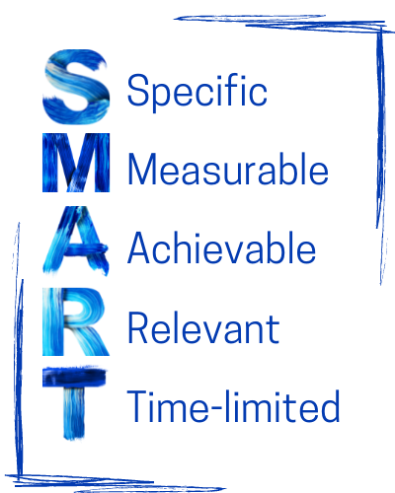
Specific: what does this goal actually look like?
Measurable: how will you track your progress? How will you know if you’ve accomplished your goal?
Achievable: what obstacles might stand in your way? Can you get around them? Have a plan.
Relevant: is this goal worth the investment in time and energy?
Time-limited: when will this be achieved? Set a deadline.

Slide 9
SMART goals: example
Goal: develop an identity as a data scientist
SMART goal: Spend 4 hours of dedicated research time each week this semester to reading papers and practicing data science skills with the goal of developing new research topics
Specific: spending research time on a particular topic
Measurable: how many hours did I spend on this each week?
Achievable: I know that teaching can fill all my time, so I am going to block out these hours in my weekly schedule
Relevant: this is literally a requirement of my job, explicitly laid out in the offer letter
Time-limited: when the semester ends, I’m going to review what I’ve learned and brainstorm some topics

Slide 10
SMART goals: let’s try it!
Pick a goal you have for yourself for this semester. Is it SMART?
Specific: what does this goal actually look like? What are you really trying to achieve?
Measurable: how will you track your progress? How will you know if you’ve accomplished your goal?
Achievable: what obstacles might stand in your way? Can you get around them? Have a plan.
Relevant: is this goal worth the investment in time and energy?
Time-limited: when will this be achieved? Set a deadline.

Slide 11
the art of goal setting
Picking deadlines
Take the deadline you set for yourself.
Now add 50% of the time you gave yourself.
That’s your new deadline
What happens when you miss a deadline?
Be kind to yourself
But learn something. Did you start too late? Was your deadline too ambitious?
Do something different next time.

Slide 12
how do we find our balance?
There’s no quick fix
Some guidelines to follow
Know your needs and your values
Learn the art of goal setting
Track your time and your progress
Learn how to say no

Slide 13
where is your time going?
It can be really hard to manage time when we don’t know how we’re spending that time
Time tracking can help you answer these questions:
Where is my time going?
How fragmented is my time?
Am I spending more time on nonessential work tasks?
Do I actually get enough time to recharge?

Slide 14
time tracking
This is common practice for lawyers and consultants, whose work is billed to different projects
The basic concept:
divide your day into 15 minute chunks
note what you are doing during each of those increments
Use an app, a spreadsheet, a notebook, whatever…

Slide 15
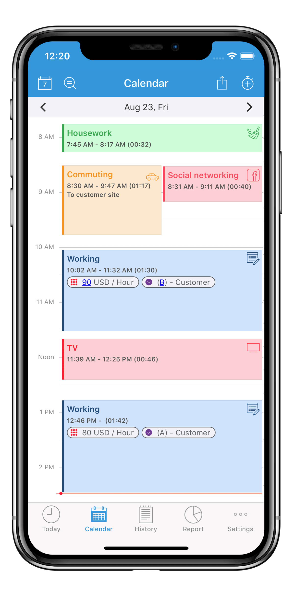
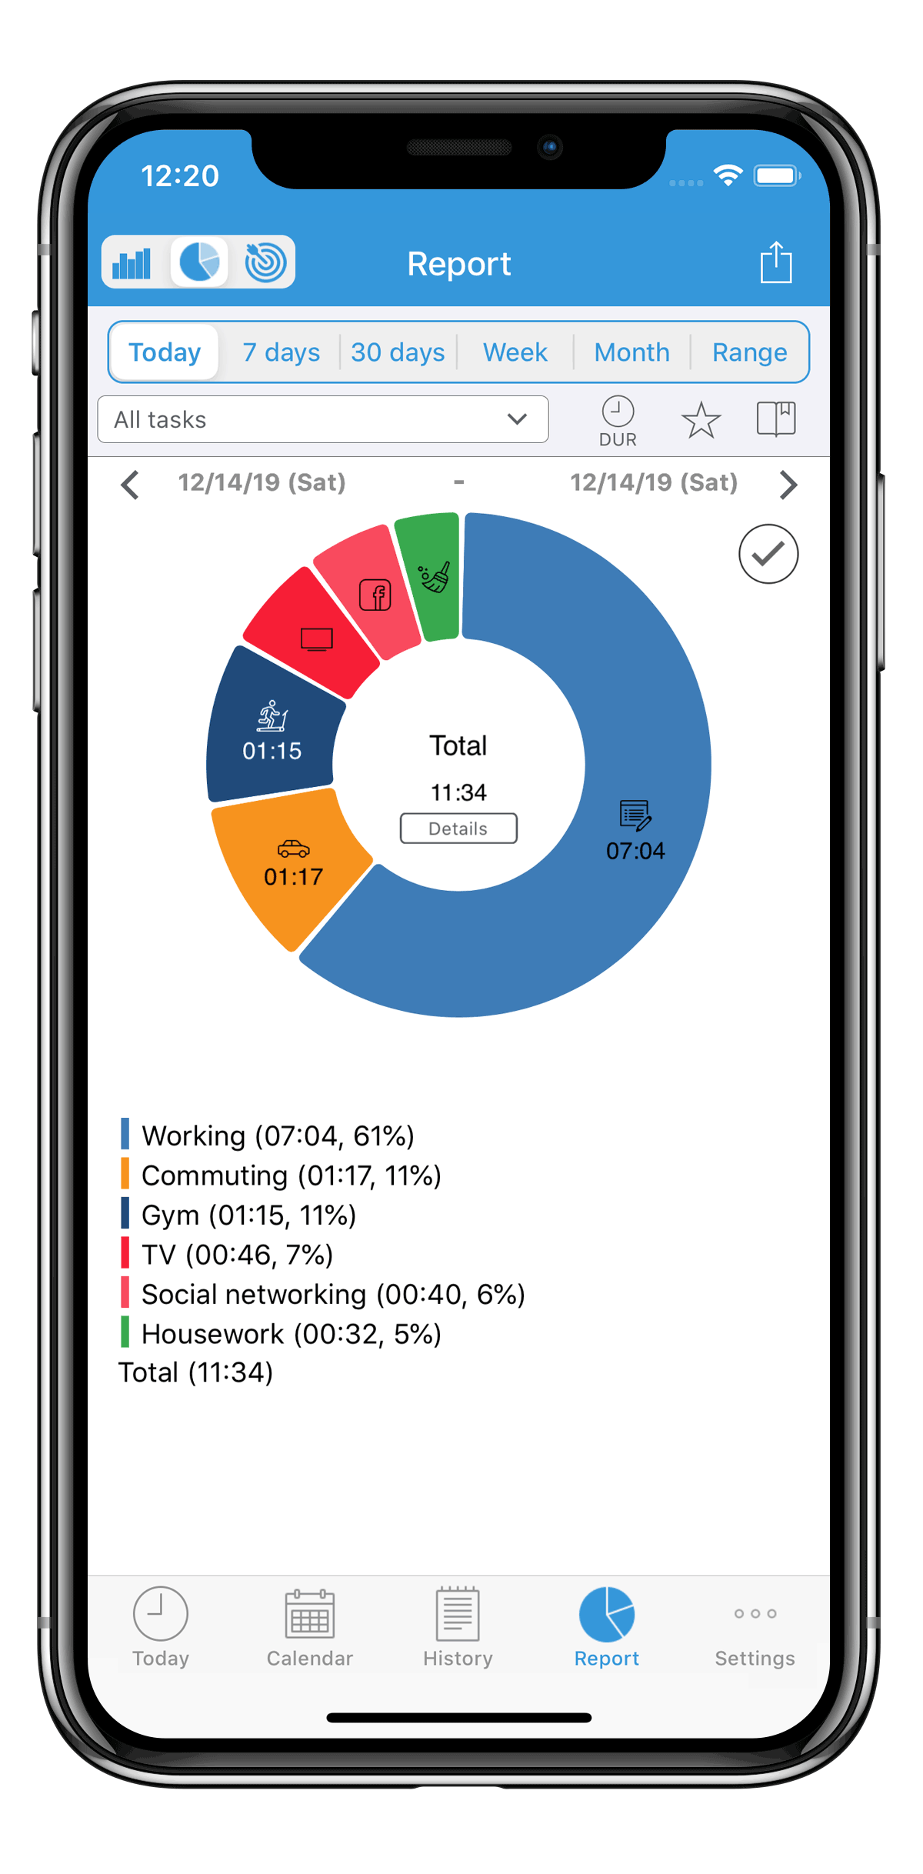
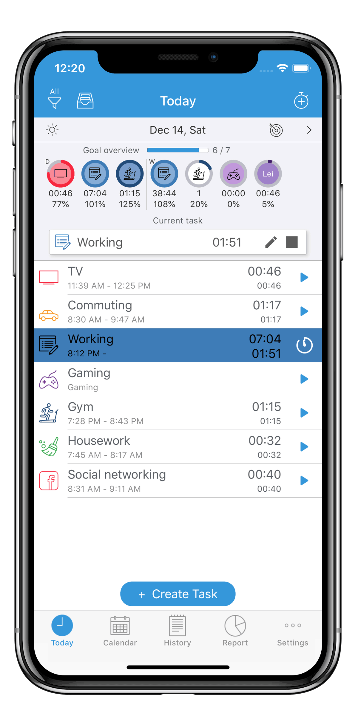
apps (e.g. Atracker)

Slide 16
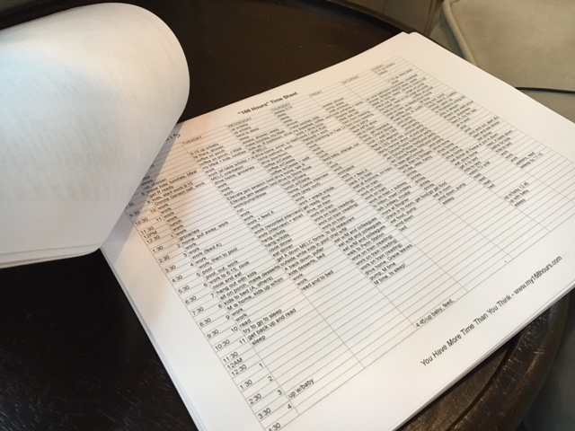
spreadsheet (e.g. excel, google sheets)

Slide 17
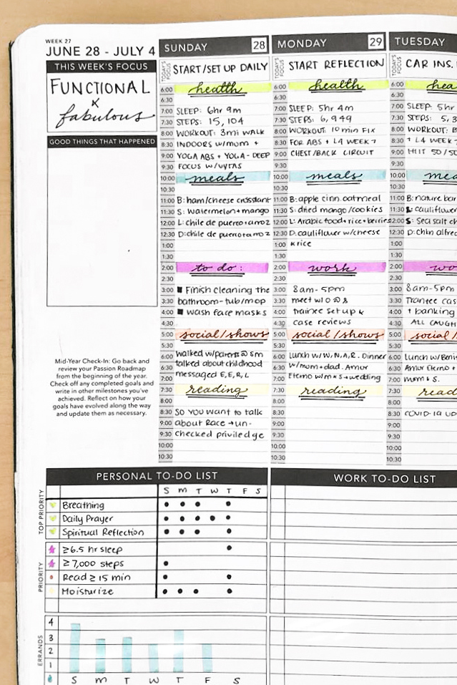
dot journal or notebook

Slide 18
benefits of time tracking
Learn what you are actually prioritizing with your time
Recognize signs of overwork
Discover time-wasters (and get rid of them!)
End result: more strategic use of your time can help you be more efficient, and therefore more productive

Slide 19
how do we find our balance?
There’s no quick fix
Some guidelines to follow
Know your needs and your values
Learn the art of goal setting
Track your time and your progress
Learn how to say no

Slide 20
you have a lot on your plate

Slide 21
how to sort through the chaos?
Write. Everything. Down.
Organize.
Prioritize.
Repeat.

Slide 22
write everything down
This seems obvious, but it’s remarkably easy to forget
Have a “brain dump document”
It might be smart to have a few places to do this, but keep it simple (1-3 total)
For example:
A physical notebook and a folder in your email inbox
A word document on your desktop and a note on your phone
Start with the brain dump document, then organize

Slide 23
activity: brain dump
Take a few minutes and write down everything that comes to your mind that needs to be done
DON’T EDIT YOURSELF

Slide 24
you can’t do everything
Prioritization is an essential skill
Saying “no” is hard, but important
A good start: “let me think about that before I give you an answer”
How do you sift through the mess?

Slide 25
urgent-important matrices
For every task on your list, ask:
Is this urgent?
Is someone expecting this from me?
Is there a deadline or a due date soon? How squishy is that due date?
Is this important?
What happens if it never gets done?
Does it align with my values?

Slide 26
prioritization: try it!
Activity:
Now, look your brain dump and plot each task on the matrix
How many things can you delegate? How many can you just not do?

Slide 27
what to do with this extra time
Don’t spend it all on work
“Why not? Won’t that make me super extra amazingly productive?”
Nope

Slide 28
limits on productivity
Studies suggest that even with years of practice and good habits, the human brain can’t maintain deep focus for more than about four hours in a day - from “Deep Work” by Cal Newport
Quality over quantity
Some shallow work is unavoidable, but the heart of what you do is deep work: don’t forget that

Slide 30
why waste time on rest and recovery?
“We live in an era when we’re urged to be passionate about our work. To regard the boundary between work and life as an obsolete relic of the industrial age. Mobile technologies keep us connected to the workplace day and night. At the same time, the boundaries between work and life are blurred, giving us more flexibility and choice about how to organize our time. Together, they create the illusion that we’ll find greatest fulfillment and be most effective if we’re always working. But that’s wrong. The positive effects of time off from work – of being able to completely leave the cares and pressures, and even the positives, of the workplace behind – are by now too well-documented to ignore, as are the negative effects of burnout.” - from “Rest” by Alex Soojung-Kim Pang

Slide 31
academic burnout
Burnout results from chronic stress and affects three areas
Physical and emotional exhaustion
Cynicism and detachment
Feelings of ineffectiveness and lack of accomplishment
It’s described by the World Health Organization as an “occupational phenomenon”

Slide 32
takeaway messages…
You need regular rest and recovery to be productive and healthy and happy
Best practices mean protecting your rest and recovery time and prioritizing what matters
There’s no “one weird trick” that will do this for you – you have to learn how to do this effectively through trial and error
Be mindful throughout this process – there is no one right way to approach it. Listen to yourself.

Slide 33
thanks!
www.caseyeberger.com/cuwip2023

Slide 34
how to overcome obstacles
WOOP
Wish: what is the wish or goal you would like to fulfill?
Outcome: what is the best result or feeling that will come from fulfilling that wish or goal?
Obstacle: what internal thing is holding you back from accomplishing your wish or goal?
Plan: If [obstacle], then I will [action]

Slide 35
how to overcome obstacles
Activity: WOOP
On a piece of paper, fill in the Wish, Outcome, Obstacle, and Plan for one goal

Slide 36
how to overcome obstacles
Mise en place
Make it easy on yourself
Take a few minutes to prepare what you need to start something with a high “activation cost”
Examples:
put out your workout clothes, shoes, and water bottle before you go to bed if you always skip your workout because it takes you too long to get ready
set up your desk at the end of the day so that all your notes are out for the project you want to work on first thing the next morning

